Slide 1
Chapter 4:
Managing Marketing Information
to Gain Customer Insights

Slide 2
Marketing Information and Customer Insights
Customer insights
Customer insights are fresh marketing information-based understandings of customers and the marketplace that become the basis for creating customer value, engagement, and relationships.
Fresh and deep insights into customer needs and wants
Important but difficult to obtain
  Needs and buying motives not obvious
  Customers usually can’t tell you what and why they buy a product
Notes:
To create value for customers and build meaningful relationships with them, marketers must first gain fresh, deep insights into what customers need and want. Such customer insights come from good marketing information. Companies use these customer insights to develop a competitive advantage.
To gain good customer insights, marketers must effectively manage marketing information from a wide range of sources.
With the recent explosion of information technologies, companies can now generate marketing information in great quantities. Moreover, consumers themselves are now generating tons of marketing information.
Far from lacking information, most marketing managers are overloaded with data and often overwhelmed by it. This problem is summed up in the concept of big data, huge and complex data sets generated by today’s sophisticated information generation, collection, storage, and analysis technologies.
Marketers don’t need more information; they need better information. They need to make better use of the information they already have.

Slide 3

Marketing Information and Customer Insights
Managing Marketing Information
Companies are forming customer insights teams
  Include all company functional areas
  Collect information from a wide variety of sources
  Use insights to create more value for their customers
Notes:
The real value of marketing research and marketing information lies in how it is used in the customer insights that it provides.
Firms are creating customer insights teams, headed by a senior marketing executive with representatives from all of the firm’s functional areas. For example, Coca-Cola’s vice president of marketing strategy and insights heads up a team of 25 strategists who develop strategy based on marketing research insights.
Customer insights groups collect customer and market information from a wide variety of sources, ranging from traditional marketing research studies to mingling with and observing consumers to monitoring social media conversations about the company and its products.

Slide 4

Marketing Information and Customer Insights
Managing Marketing Information
Marketing information system (MIS) refers to the people and procedures dedicated to assessing information needs, developing the needed information, and helping decision makers to use the information to generate and validate actionable customer and market insights.
Notes:
Companies must design effective marketing information systems that give managers the right information, in the right form, at the right time and help them to use this information to create customer value and stronger customer relationships.

Slide 5
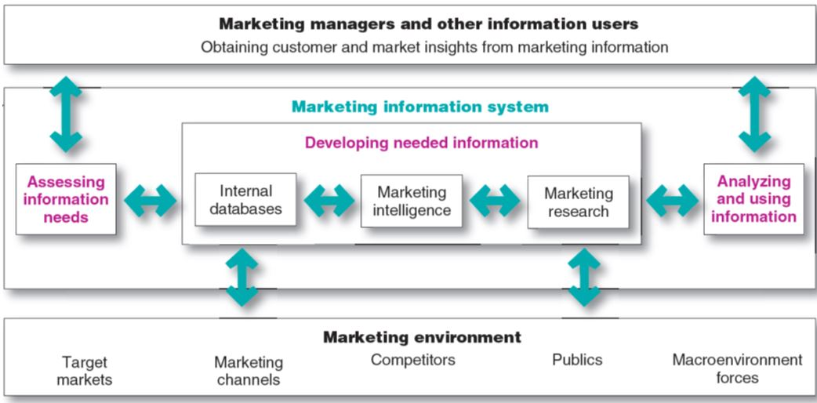
Managing Marketing Information
Marketing Information and Customer Insights
FIGURE | 4.1 The Marketing Information System
Notes:
Figure 4.1 shows that MIS begins and ends with information users—marketing managers, internal and external partners, and others who need marketing information. First, it interacts with these information users to assess information needs. Next, it interacts with the marketing environment to develop needed information through internal company databases, marketing intelligence activities, and marketing research. Finally, the MIS helps users to analyze and use the information to develop customer insights, make marketing decisions, and manage customer relationships.

Slide 6
Assessing Marketing Information Needs
A marketing information system (MIS) provides information to the company’s marketing and other managers and external partners such as suppliers, resellers, and marketing service agencies.
Notes:
The marketing information system primarily serves the company’s marketing and other managers. However, it may also provide information to external partners, such as suppliers, resellers, or marketing services agencies. For example, Wal-Mart's Retail Link system gives key suppliers access to information on everything from customers’ buying patterns and store inventory levels to how many items they’ve sold in which stores in the past 24 hours.

Slide 7
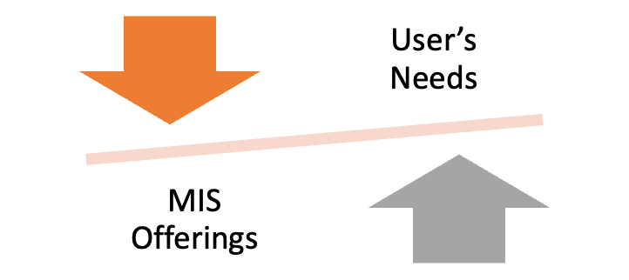
Assessing Marketing Information Needs
Characteristics of a Good MIS
Balancing the information users would like to have against what they need and what is feasible to offer
Notes:
A good MIS balances the information users would like to have against what they really need and what is feasible to offer. Some managers will ask for whatever information they can get without thinking carefully about what they really need. Too much information can be as harmful as too little.
Other managers may omit things they ought to know, or they may not know to ask for some types of information they should have. For example, managers might need to know about surges in favorable or unfavorable consumer discussions about their brands on blogs or online social networks. Because they do not know about these discussions, they do not think to ask about them.
The MIS must monitor the marketing environment to provide decision makers with information they should have to better understand customers and make key marketing decisions.
The company must decide whether the value of insights gained from additional information is worth the costs of providing it, and both value and cost are often hard to assess.

Slide 8
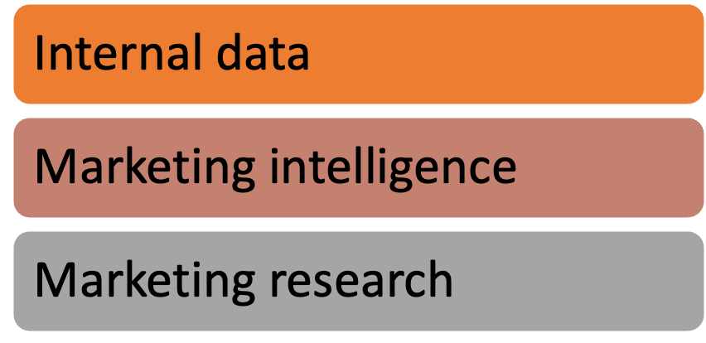
Developing Marketing Information
Marketers obtain information from
Notes:
The problem isn’t finding information; the world is bursting with information from a glut of sources. The real challenge is to find the right information—from inside and outside sources—and turn it into customer insights.

Slide 9
Developing Marketing Information
Internal Data
Internal databases are collections of consumer and market information obtained from data sources within the company network.
Sales
Finance
Marketing
Human resource
Notes:
Many companies build extensive internal databases, electronic collections of consumer and market information obtained from data sources within the company’s network. Information in the database may include:
information on customer characteristics
sales transactions
website visits
customer satisfaction and service records
records of sales, costs, and cash flows
reports on production, shipments, and inventories
reports on reseller reactions and competitor activities
point-of-sale transaction data
Harnessing such information can provide powerful customer insights and strong competitive advantage.
Internal databases usually can be accessed more quickly and cheaply than other information sources. However, the data is often collected for other purposes, so it may be incomplete or in the wrong form. Keeping the database current also requires special effort, equipment, and techniques.

Slide 10
Developing Marketing Information
Marketing Intelligence
Marketing intelligence is the systematic collection and analysis of publicly available information about consumers, competitors, and developments in the marketing environment.
    Commercial databases
    Business newspapers
    Chamber of commerce directories
    Networking
    Exhibitions
Notes:
The goal of competitive marketing intelligence is to improve strategic decision making by understanding the consumer environment, assessing and tracking competitors’ actions, and providing early warnings of opportunities and threats. Marketing intelligence techniques range from:
observing consumers firsthand
quizzing the company’s own employees
benchmarking competitors’ products
researching the Internet
monitoring Internet buzz
Good marketing intelligence can help marketers gain insights into how consumers talk about and connect with their brands. Many companies send out teams of trained observers.
Companies also need to actively monitor competitors’ activities. Firms use competitive marketing intelligence to gain early warnings of competitor moves and strategies, new-product launches, new or changing markets, and potential competitive strengths and weaknesses. Much competitor intelligence can be collected from:
people inside the company
suppliers, resellers, and key customers
monitoring competitors’ websites
Internet searches of specific competitor names, events, or trends
tracking consumer conversations about competing brands and the company’s own brands
thousands of online databases
The intelligence game goes both ways. Facing determined competitive marketing intelligence efforts by competitors, most companies are now taking steps to protect their own information.
The growing use of marketing intelligence also raises ethical issues. Some intelligence gathering techniques may involve questionable ethics.

Slide 11
Marketing Research
Marketing research is the systematic design, collection, analysis, and reporting of data relevant to a specific marketing situation facing an organization.
Notes:
Whereas marketing intelligence involves actively scanning the general marketing environment, marketing research involves more focused studies to gain customer insights relating to specific marketing decisions.
In addition to marketing intelligence information about general consumer, competitor, and marketplace happenings, marketers often need formal studies that provide customer and market insights for specific marketing situations and decisions.
Companies use marketing research in a wide variety of situations. For example, marketing research enables marketers to:
gain insights into customer motivations, purchase behavior, and satisfaction
assess market potential and market share
measure the effectiveness of pricing, product, distribution, and promotion activities
Some large companies have their own research departments that work with marketing managers on marketing research projects. In addition, these companies—like their smaller counterparts—frequently hire outside research specialists to consult with management on specific marketing problems and to conduct marketing research studies. Sometimes firms simply purchase data collected by outside firms to aid in their decision making.

Slide 12
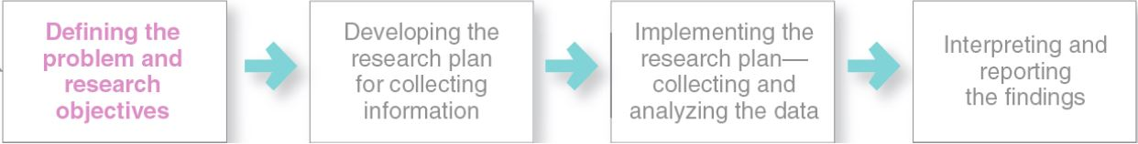
Marketing Research
Steps in the Marketing Research Process
The Marketing Research Process
Notes:
As shown in Figure 4.2, the marketing research process has four steps: defining the problem and research objectives, developing the research plan, implementing the research plan, and interpreting and reporting the findings.
The first step is probably the most difficult but also the most important one. It guides the entire research process. It’s frustrating to reach the end of an expensive research project only to learn that you’ve addressed the wrong problem!

Slide 13
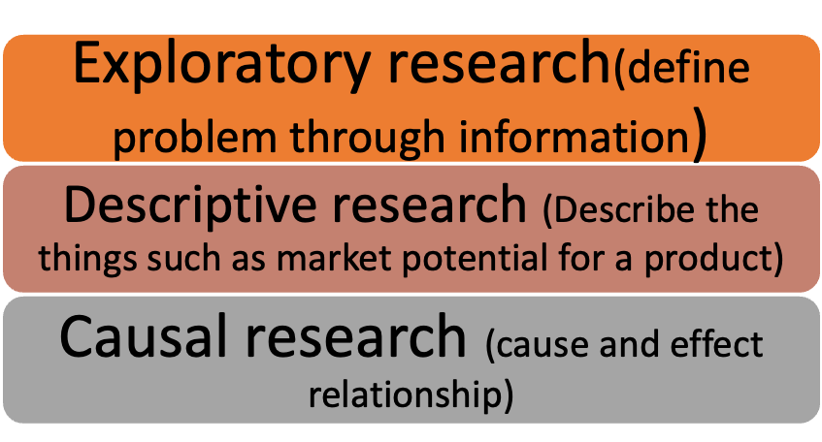
Defining the Problem and Research Objectives
Notes:
Discussion Question
Consider a local business near campus. . .
How would they conduct exploratory research?
What might they want to find out in descriptive research?
What relationships might they explore in causal research?
Students will have the following responses for the above questions: exploratory research (focus groups, interviews); descriptive research (who, when, how, why);causal research (price/demand, environment/purchase rate).
The objective of exploratory research is to gather preliminary information that will help define the problem and suggest hypotheses. Descriptive research describes marketing problems, situations, or markets, such as the market potential for a product or the demographics and attitudes of consumers. Causal research tests hypothesis about cause-and-effect relationships.
The statement of the problem and research objectives guides the entire research process. The manager and the researcher should put the statement in writing to be certain that they agree on the purpose and expected results of the research.

Slide 14
Developing the Research Plan
Outlines sources of existing data (Secondary, Primary)
Identify specific research approaches (Observational, Survey, Ethnographic, Experimental)
Contact methods (Mail, Telephone, Personal , online)
Sampling plans (Probability, non-probability)
Instruments to gather data (Questionnaire, interviews, focus group)
Notes:
Once researchers have defined the research problem and objectives, they must determine the exact information needed, develop a plan for gathering it efficiently, and present the plan to management. The research plan outlines sources of existing data and spells out the specific research approaches, contact methods, sampling plans, and instruments that researchers will use to gather new data.
Research objectives must be translated into specific information needs. A decision by Red Bull to add a line of enhanced waters to its already successful mix of energy drinks would call for marketing research that provides lots of specific information.

Slide 15
Marketing Research
Developing the Research Plan
Secondary data is information that already exists somewhere, having been collected for another purpose.
Primary data is information collected for the specific purpose at hand.
Notes:
To meet the manager’s information needs, the research plan can call for gathering secondary data, primary data, or both.
Secondary data consist of information that already exists somewhere, having been collected for another purpose. Primary data consist of information collected for the specific purpose at hand.
Researchers usually start by gathering secondary data. The company’s internal database provides a good starting point. However, the company can also tap into a wide assortment of external information sources.

Slide 16
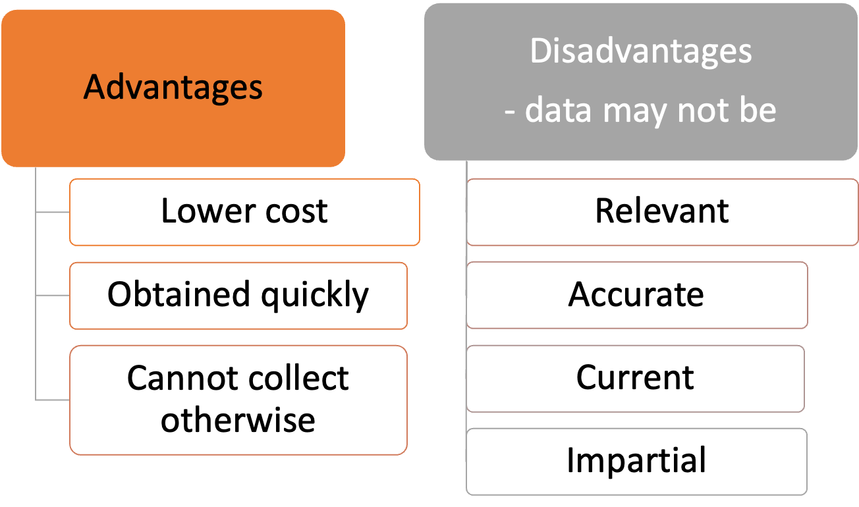
Gathering Secondary Data
Notes:
It would be too expensive for Red Bull’s marketers to conduct a continuing retail store audit to find out about the market shares, prices, and displays of competitors’ brands. Rather than conduct a retail store audit, marketers can buy secondary data.
The InfoScan service from SymphonyIRI Group, which provides valuable information based on scanner and other data from 34,000 retail stores in markets around the nation.
Secondary data can also present problems as shown in the disadvantages in the slide. In addition, researchers rarely obtain all the data they need from secondary sources.
For example, Red Bull will not find existing information regarding consumer reactions about a new enhanced-water line that it has not yet placed on the market.

Slide 17
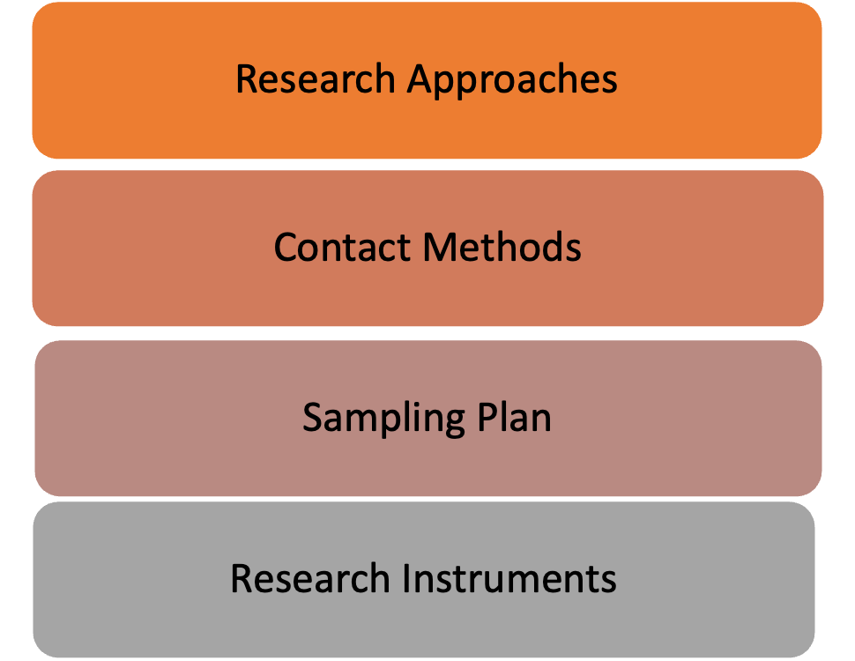
Primary Data Collection
Notes:
Secondary data provides a good starting point for research and often help to define research problems and objectives. In most cases, however, the company must also collect primary data. Designing a plan for primary data collection calls for a number of decisions on research approaches, contact methods, the sampling plan, and research instruments.

Slide 18
Primary Data Collection
Research Approaches
Observational research involves gathering primary data by observing relevant people, actions, and situations.
Ethnographic research involves sending trained observers to watch and interact with consumers in their “natural environments.”
Notes:
Researchers often observe consumer behavior to glean customer insights they can’t obtain by simply asking customers questions. With observational research, marketers not only observe what consumers do but also observe what consumers are saying. The observers might be trained anthropologists and psychologists or company researchers and managers.
Beyond conducting ethnographic research in physical consumer environments, many companies now routinely conduct Netnography research—observing consumers in a natural context on the Internet and mobile space.
Observational and ethnographic research often yield the kinds of details that just don’t emerge from traditional research questionnaires or focus groups. Whereas traditional quantitative research approaches seek to test known hypotheses and obtain answers to well defined product or strategy questions, observational research can generate fresh customer and market insights that people are unwilling or unable to provide. It provides a window into customers’ unconscious actions and unexpressed needs and feelings.

Slide 19
Primary Data Collection
Research Approaches
Survey research involves gathering primary data by asking people questions about their knowledge, attitudes, preferences, and buying behavior.
Experimental research involves gathering primary data by selecting matched groups of subjects, giving them different treatments, controlling related factors, and checking for differences in group responses.
Notes:
Survey research, the most widely used method for primary data collection, is the approach best suited for gathering descriptive information. A company that wants to know about people’s knowledge, attitudes, preferences, or buying behaviors can often find out by asking them directly. The major advantage of survey research is its flexibility; it can be used to obtain many different kinds of information in many different situations.
However, survey research also presents some problems. Sometimes people are unable to answer survey questions or unwilling to respond to unknown interviewers or about things they consider private. Respondents may answer survey questions even when they do not know the answer just to appear smarter or more informed. Or they may try to help the interviewer by giving pleasing answers. Finally, busy people may not take the time, or they might resent the intrusion into their privacy.
Experimental research is best suited for gathering causal information.

Slide 20
Contact Methods
Mail
Telephone
Personal
Online
Copyright © 2016 Pearson Education, Inc.

Slide 21
Primary Data Collection
Research Instruments—Questionnaires
Most common
In person, by phone, or online
Flexible
Researchers must be careful with wording and ordering of questions
  Closed-ended
  Open-ended
Useful in exploratory research
Notes:
Discussion Question
Ask students the disadvantages of open-ended questions.
Students might realize from their own experience that they get tired filling out many open ended questions and that they often lead to hard-to-code information.
Questionnaires are very flexible—there are many ways to ask questions. Closed-end questions include all the possible answers, and subjects make choices among them. Examples include multiple-choice questions and scale questions. Open-end questions allow respondents to answer in their own words.
Open-end questions are especially useful in exploratory research, when the researcher is trying to find out what people think but is not measuring how many people think in a certain way.
Closed-end questions, on the other hand, provide answers that are easier to interpret and tabulate.

Slide 22

Primary Data Collection
Focus Group – Personal Contact Method
  Six to 10 people
  Trained moderator
  Challenges
    Expensive
    Difficult to generalize from small group
    Consumers not always open and honest
Notes:
Discussion Question
Ask students if they have been participants in or worked as researchers on a professional focus group. Ask them about the product, the other participants, and the results the researcher obtained. Ask them to put themselves in the role of the moderator and ask them what problems they might have when running the focus group.
A partial list might include:
Over-participants
Quiet participants
Keeping the group on track
Meeting the needs of the client
Group interviewing consists of inviting six to ten people to meet with a trained moderator to talk about a product, service, or organization. Participants normally are paid a small sum for attending. A moderator encourages free and easy discussion, hoping that group interactions will bring out actual feelings and thoughts. At the same time, the moderator “focuses” the discussion—hence the name focus group interviewing.

Slide 23
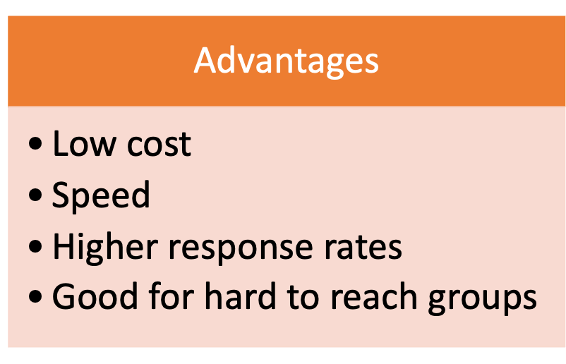
Primary Data Collection
Online Contact Methods
Notes:
Online research usually costs much less than research conducted through mail, phone, or personal interviews. Using the Internet eliminates most of the postage, phone, interviewer, and data-handling costs associated with the other approaches. Moreover, sample size has little impact on costs. Once the questionnaire is set up, there’s little difference in cost between 10 respondents and 10,000 respondents on the Internet.
Its low cost puts online research well within the reach of almost any business, large or small. In fact, with the Internet, what was once the domain of research experts is now available to almost any would-be researcher. Even smaller, less sophisticated researchers can use online survey services such as Snap Surveys (www.snapsurveys.com) and SurveyMonkey (www.surveymonkey.com) to create, publish, and distribute their own custom surveys in minutes.
Internet-based surveys also tend to be more interactive and engaging, easier to complete, and less intrusive than traditional phone or mail surveys. As a result, they usually garner higher response rates.

Slide 24
Marketing Research
Primary Data Collection
Sampling Plan
A sample is a segment of the population selected for marketing research to represent the population as a whole.
  Who is to be studied?
  How many people should be studied?
  How should the people be chosen?
Notes:
Marketing researchers usually draw conclusions about large groups of consumers by studying a small sample of the total consumer population.

Slide 25
Primary Data Collection
Sampling Plan – Types of Samples
Probability Sample
Simple random sample | Every member of the population has a known and equal chance of selection.
Stratified random sample | The population is divided into mutually exclusive groups and random samples are drawn from each group.
Cluster (area) sample | The population is divided into mutually exclusive groups and the researcher draws a sample from selected clusters.
Nonprobability Sample
Convenience sample | The researcher selects the easiest population members.
Judgment sample | The researcher uses their judgment to select population members.
Quota sample | The researcher finds and interviews a prescribed number of people in each of several categories.
Notes:
Finally, how should the people in the sample be chosen (what sampling procedure)? Table 4.3 describes different kinds of samples. These varied ways of drawing samples have different costs and time limitations as well as different accuracy and statistical properties. Which method is best depends on the needs of the research project.

Slide 26
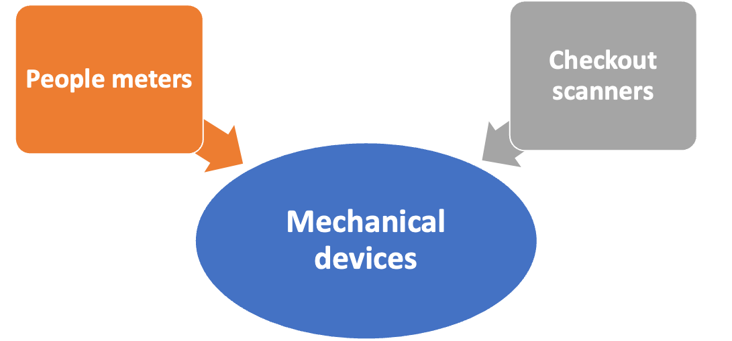
Marketing Research
Primary Data Collection
Mechanical Research Instruments
Notes:
Although questionnaires are the most common research instrument, researchers also use mechanical instruments to monitor consumer behavior. Nielsen Media Research attaches people meters to television sets, cable boxes, and satellite systems in selected homes to record who watches which programs. Retailers likewise use checkout scanners to record shoppers’ purchases. Other mechanical devices measure subjects’ physical responses to marketing offerings.
Time Warner’s Medialab uses biometric measures to analyze every game that subjects play, every reality show they watch, or every commercial they skip. Biometric belts and recording devices transmit detailed data like heart rate, skin temperature, and facial movements that researchers use to decipher viewer engagement.
Still other researchers are applying neuromarketing, measuring brain activity to learn how consumers feel and respond.

Slide 27
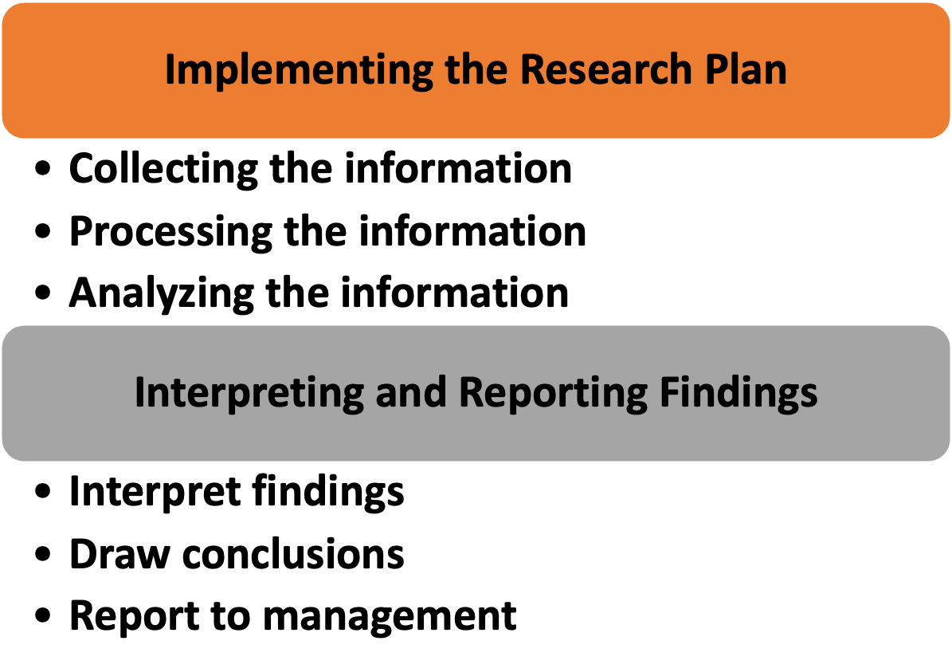
Marketing Research
Notes:
The researcher next puts the marketing research plan into action. Researchers should watch closely to make sure that the plan is implemented correctly. They must guard against problems of interacting with respondents, with the quality of participants’ responses, and with interviewers who make mistakes or take shortcuts. Researchers must also process and analyze the collected data to isolate important information and insight. They need to check data for accuracy and completeness and code it for analysis. The researchers then tabulate the results and compute statistical measures.
The researcher should not try to overwhelm managers with numbers and fancy statistical techniques. Rather, the researcher should present important findings and insights that are useful in the major decisions faced by management. However, interpretation should not be left only to researchers. Although they are often experts in research design and statistics, the marketing manager knows more about the problem and the decisions that must be made. Thus, managers and researchers must work together closely when interpreting research results, and both must share responsibility for the research process and resulting decisions.

Slide 28
Analyzing and Using Marketing Information
Customer Relationship Management (CRM)
CRM involves managing detailed information about individual customers and carefully managing customer touch points to maximize customer loyalty.
Notes:
Information gathered in internal databases and through competitive marketing intelligence and marketing research usually requires additional analysis. Managers may need help applying the information to gain customer and market insights that will improve their marketing decisions. This help may include advanced statistical analysis to learn more about the relationships within a set of data. Information analysis might also involve the application of analytical models that will help marketers make better decisions.
Once the information has been processed and analyzed, it must be made available to the right decision makers at the right time. In the following sections, we look deeper into analyzing and using marketing information.

